Slide 1
TOPIC A:
DATABASES
LESSON A-13
DATA MATCHING & MINING

Slide 2
AGENDA
Data Matching
Data Mining
NOTE!
Have a way to take notes available for this lesson

Slide 3

THE WARM UP QUESTION
What are two ways that databases can protect user data, and how do they work?

Slide 4
THE WARM UP ANSWER
Encryption – scramble data using a key to protect it
Access Control – accessing data only with correct permissions in the organization
Anonymization – remove personally identifying information
Data minimization – collect only what is explicitly necessary
Audits – detect unauthorized use or access of data

Slide 5
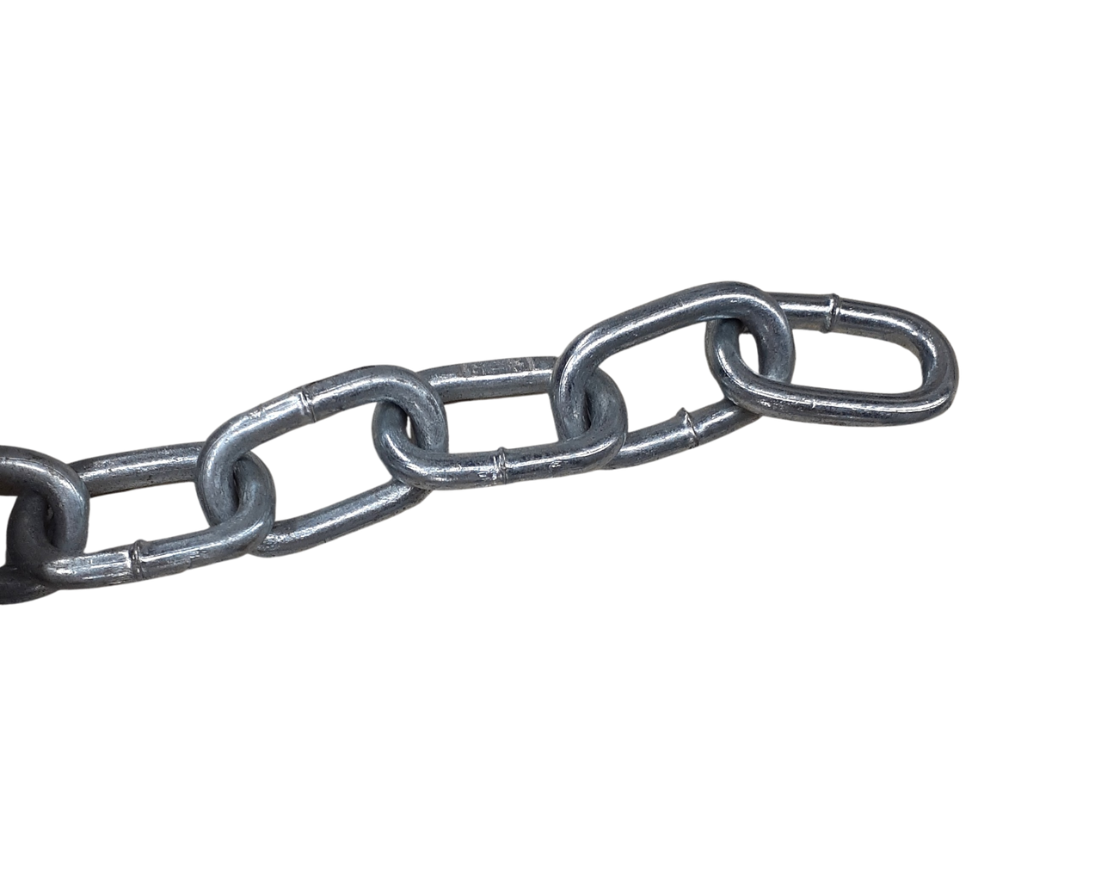
DATA MATCHING
Data matching
Also known as record linkage
Technique that connects information about the same entity but are stored in different data sources
The main goal is to provide a unified view of data spread across various datasets
What might be a situation where this could be very useful for an organization?

Slide 6

DATA MATCHING
This could be useful for hospitals linking records for the same patient together
This provides a more complete account of a patient’s medical history

Slide 7

DATA MATCHING
The actual data used to make this link can vary
Exact matching: Fields that uniquely identify a person
SSN
Fuzzy matching: Accounts for variation in the data
Phone Numbers + Address

Slide 8
DATA MATCHING
Accuracy of data
If a match is made inaccurately this could have consequences
Banking
Health
Security/Privacy
Data being open to matching leads to more people that can access it

Slide 9
DATA MINING
Data Mining
Analytical process designed to explore large sets of data
Find patterns and relationships between variables
Validate findings by checking patterns against new subsets of data

Slide 10
DATA MINING
With this information we can do lots of things
Retailers can predict customer behavior
Financial institutions can assess loan risks

Slide 11

DATA MINING
With this data we can classify data
This is used in filtering spam/fraud emails and calls
We can also cluster data together
Group customers with similar behavior
Detect association between items
Group items that are often purchased together

Slide 12
DATA MINING
Personal Identifiable Information (PII) can be exposed when mining data
This leads to privacy concerns
There is an argument to made that this is profiling and can lead to discrimination or is unethical
Target and diapers

Slide 13
DATA MINING
Personal Identifiable Information (PII) can be exposed when mining data
This leads to privacy concerns
There is an argument to made that this is profiling and can lead to discrimination or is unethical
Target and diapers

Slide 14
DATA MINING VS MATCHING
Purpose:
Mining: Extract patterns and correlations to predict outcomes
Matching: Link records corresponding to the same entity across databases
Processes:
Mining: Complex statistical analysis and machine learning
Matching: Requires algorithms to compare and find potential matches

Slide 15
DATA MINING VS MATCHING
Privacy & Security Concerns:
Data Mining: Issues of surveillance and abuse in inferring sensitive information
Data Matching: Wrongful linking of records, leading to false assumptions

Slide 16
DATA MINING AND MATCHING
Ethical & Social Considerations:
Consent & Ownership
Users aren’t always made clear about what data is stored, and that it is being matched & mined
Who owns the result of data mining or matching?
Transparency & Accountability
Are the algorithms that make these connections transparent and available?
Are organizations held accountable for decisions made based on matched/mined data

Slide 17
DATA MINING AND MATCHING
We discussed last time the lack of legislation that addresses data privacy and security
When data from multiple databases is paired together with matching, who should even be held accountable?

Slide 18

DATA MINING AND MATCHING
To avoid some of these concerns:
Anonymize data used when mining
Security protocols used when sensitive info is being matched
Ensure results are used in a manner that respects individual rights

Slide 19
WS A-4 REVIEW
WS A-4: The Exam Review is up on GitHub!

Slide 20

VOCAB TO REMEMBER
Data Mining
Data Matching
Exact Matching
Fuzzy Matching
Classified Data
Clustered Data
Association

